Slide 1

Pytorch Tutorial
Weitai Kang

Slide 2
Agenda
Popular Frameworks
Pytorch, Basics (Tensor)
Pytorch, Deep Learning (model, training, ...)
(if we have time ....)

Slide 3
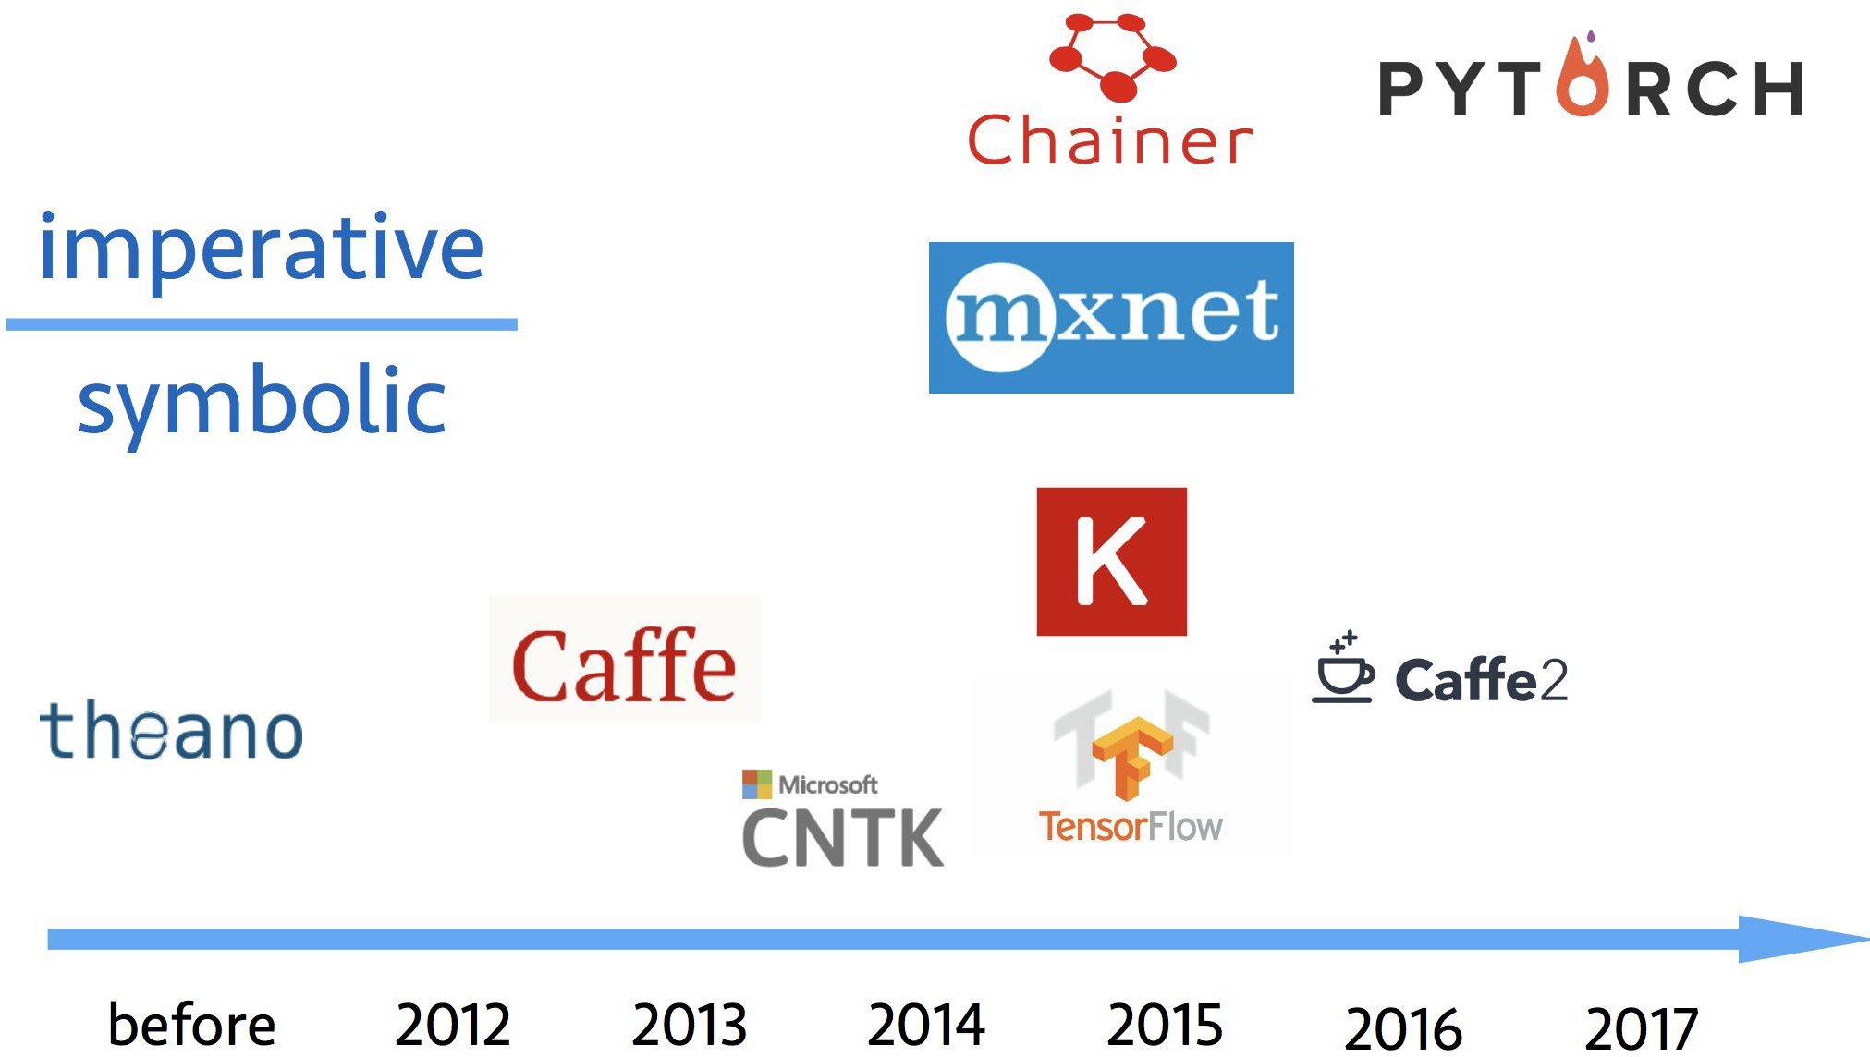
Popular Deep Learning Frameworks
Gluon: new MXNet interface to accelerate research

Slide 4
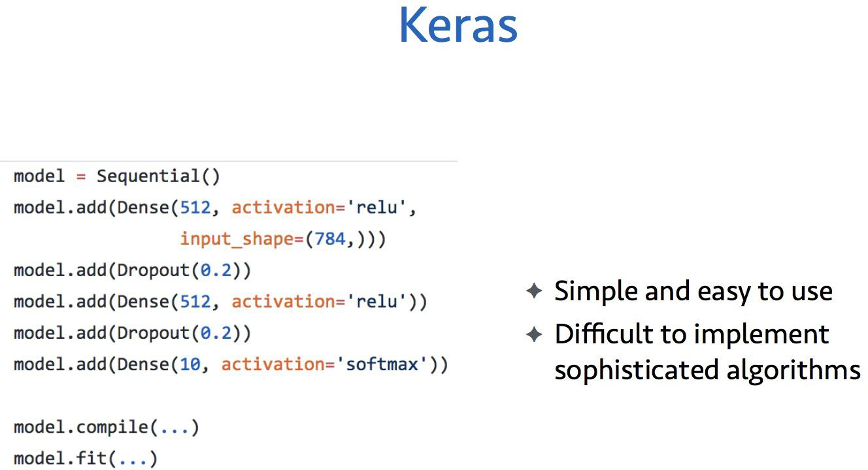
MxNet Tutorial, CVPR 2017

Slide 5
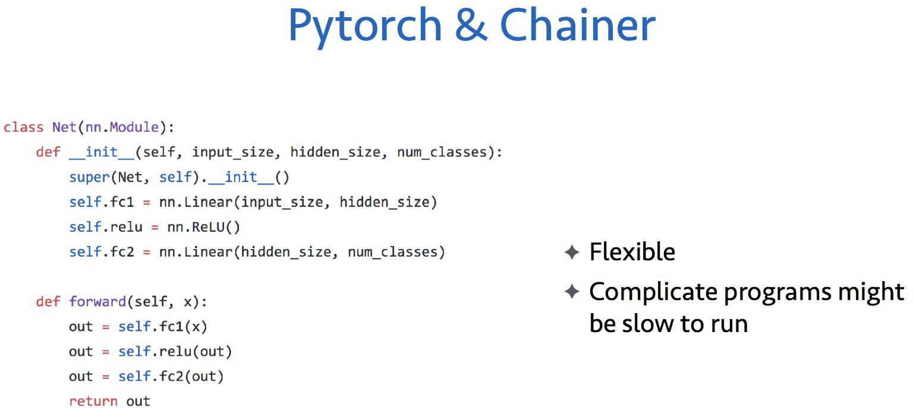
MxNet Tutorial, CVPR 2017

Slide 6
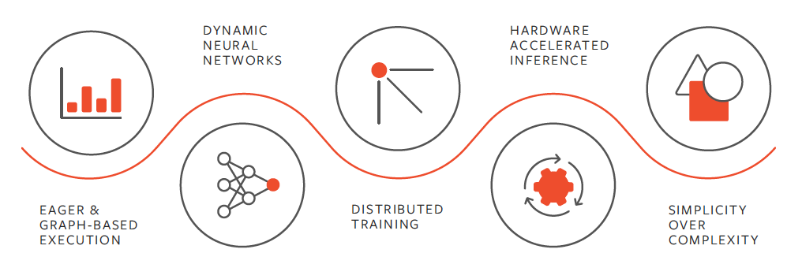

What is PyTorch?
1. An open source machine learning framework based on Python.
2. Used for applications using GPUs and CPUs.

Slide 7
What is PyTorch?
1. PyTorch is Pythonic, which means that Python developers should feel more comfortable while coding with PyTorch than with other deep learning frameworks.
2. Easy to learn and complete libraries.
3. Strong community
4. Data Parallelism: Using this feature, PyTorch can distribute computational work among multiple CPU or GPU cores.
5. GPU acceleration.

Slide 8
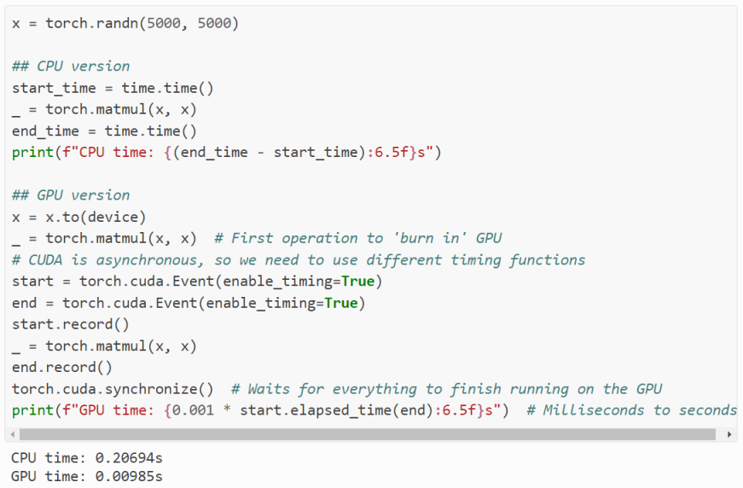
5. GPU acceleration. Depending on the size of the operation and the CPU/GPU in your system, the speedup of this operation can be >50x.

Slide 9
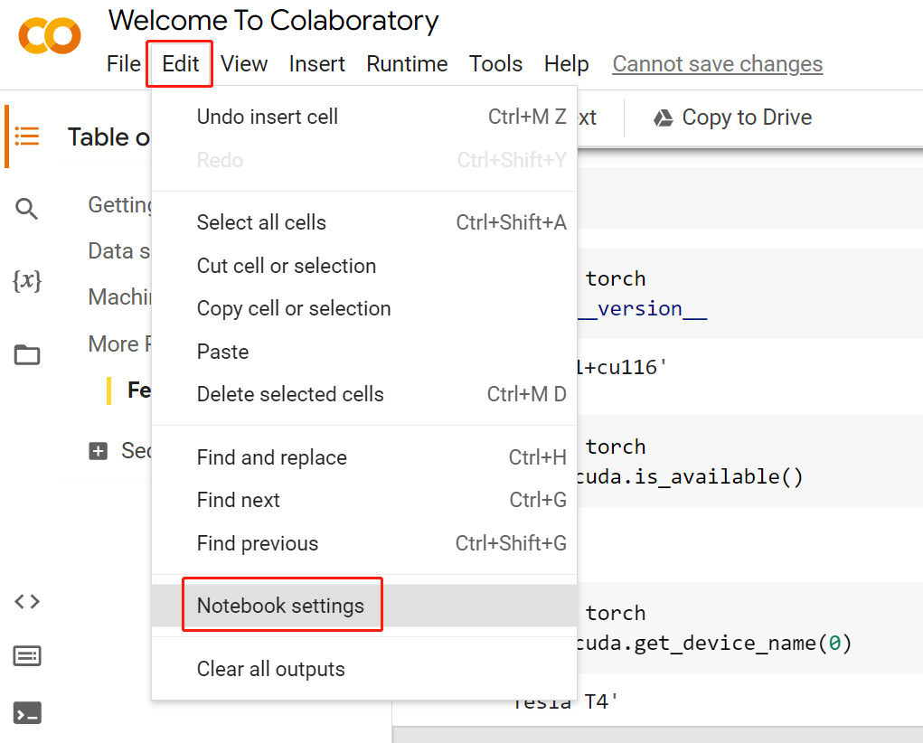
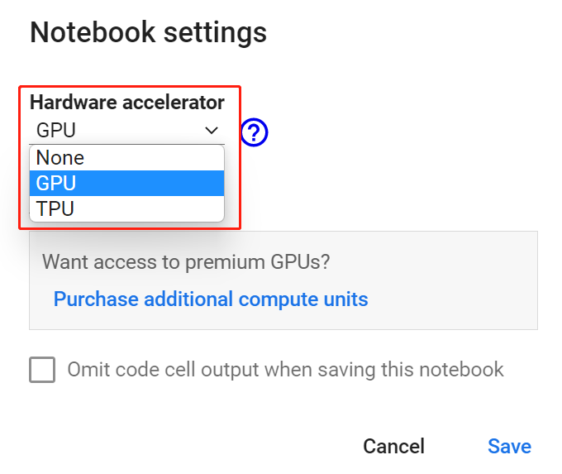
Using GPU resource on Colab
Go to Colab, “Edit”, “Notebook setting”
Choose GPU as the hardware

Slide 10
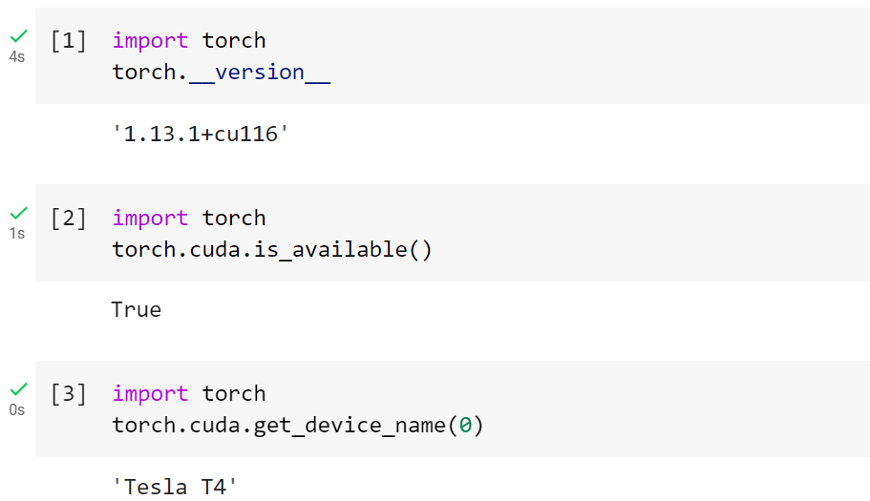
Import PyTorch
Let's start by importing PyTorch and checking the version we're using.

Slide 11
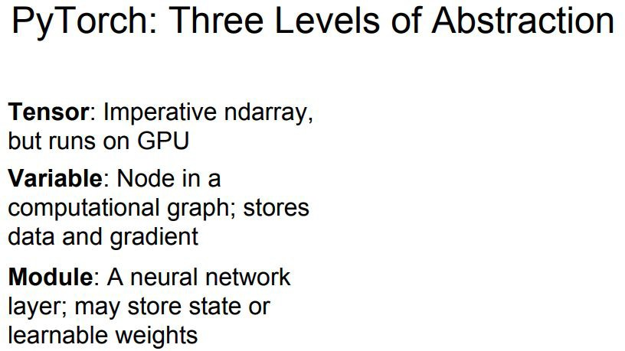
Stanford cs231n.

Slide 12
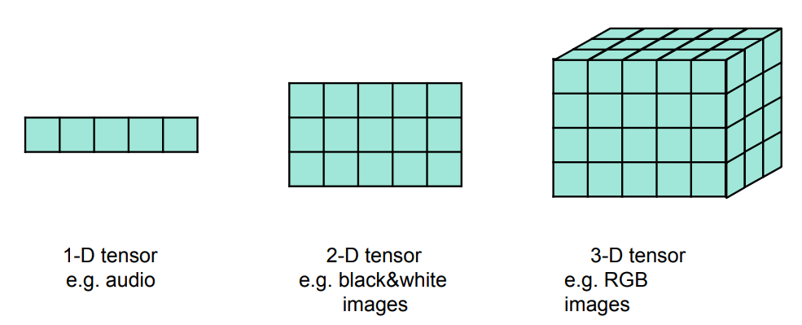
Tensors
Tensors are a fundamental and specialized data structure similar to Numpy arrays.

Slide 13
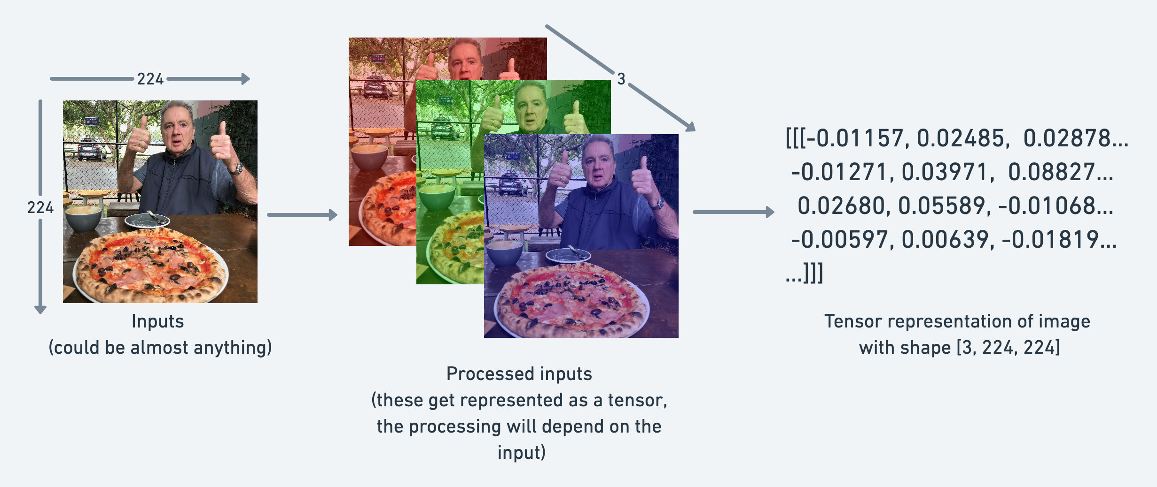
For example, an image as a tensor with shape [3,224,224] which would mean [color_channels, height, width], as in the image has 3 color channels (red, green, blue), a height of 224 pixels and a width of 224 pixels.

Slide 14
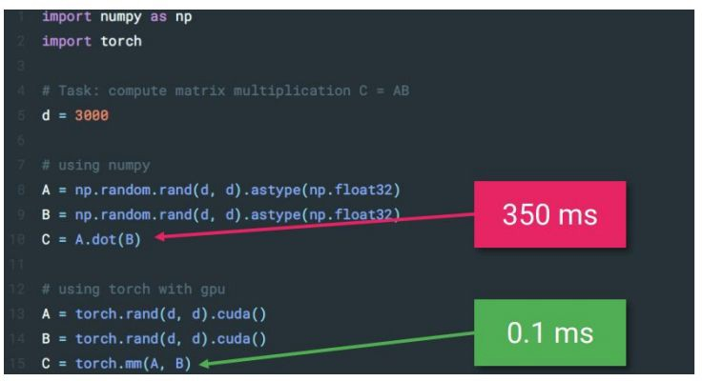
Pytorch Tensors
https://transfer.d2.mpi-inf.mpg.de/rshetty/hlcv/Pytorch_tutorial.pdf

Slide 15
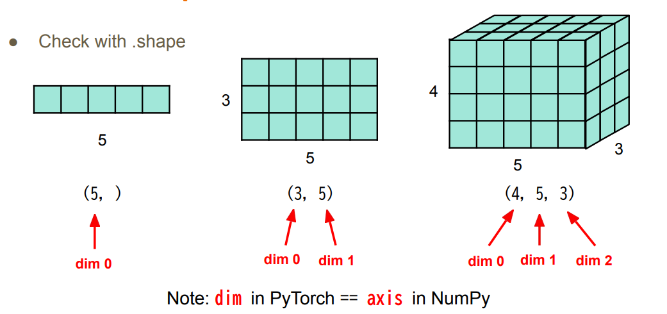
Tensors – Shape of Tensors
Tensors.shape

Slide 16
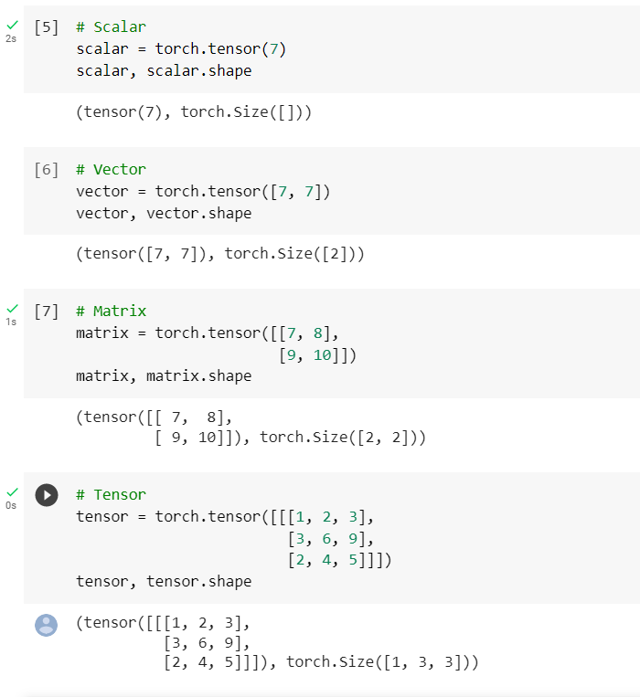
Tensors – Create
There are many possible options.
Directly from data
torch.tensor()
torch.from_numpy()
Tensor of constant or random variables
torch.zeros([2, 2])
torch.rand(2,2)
Shape

Slide 17
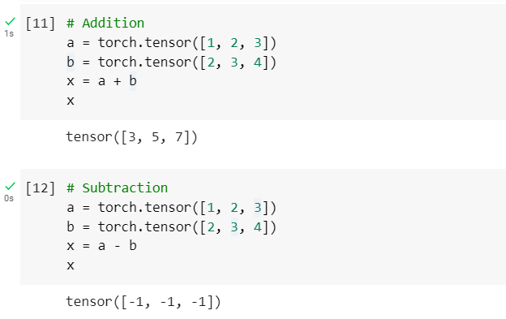
Tensors – Common Operations
Common operations are supported, such as；
Addition
Subtraction

Slide 18
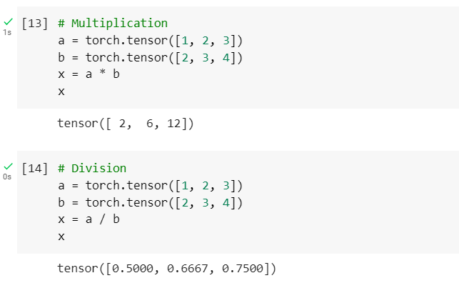
Tensors – Common Operations
Common operations are supported, such as；
Multiplication
Division

Slide 19
Tensors – Common Operations
Common operations are supported, such as；
Matrix multiplication
The inner dimension must match.
(3, 2) @ (3, 2) won’t work
(3, 2) @ (2, 3) will work
(2, 3) @ (3, 2) will work
The resulting matrix has the shape of the outer dimensions.
(2, 3) @ (3, 2) -> (2, 2)
(3, 2) @ (2, 3) -> (3, 3)

Slide 20
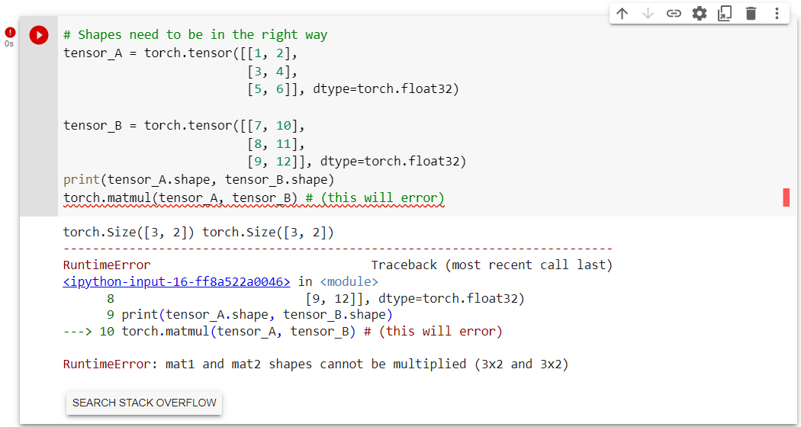
Tensors – Common Operations
Common operations are supported, such as；
Matrix multiplication

Slide 21
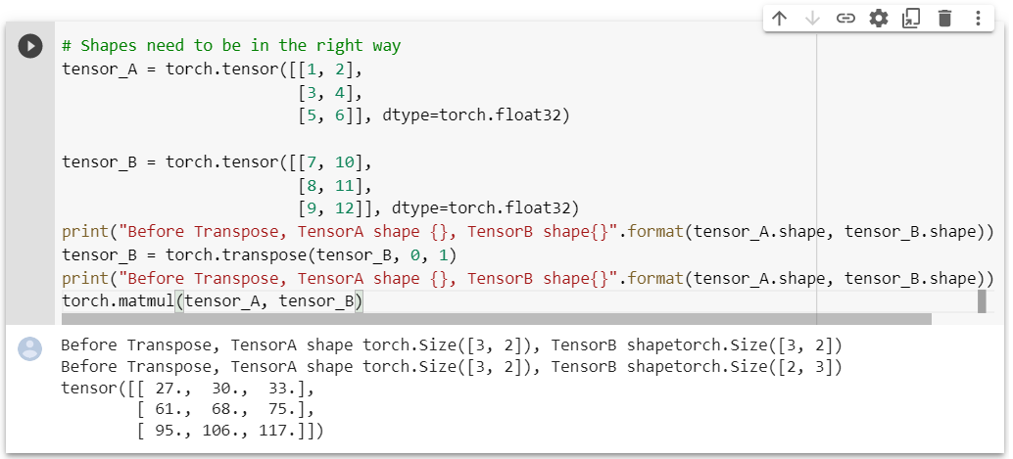
Tensors – Common Operations
Common operations are supported, such as；
Matrix multiplication

Slide 22
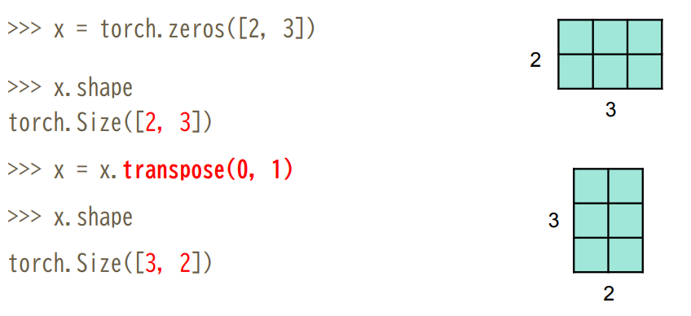
Tensors – Common Operations
Transpose: transpose two specified dimensions

Slide 23
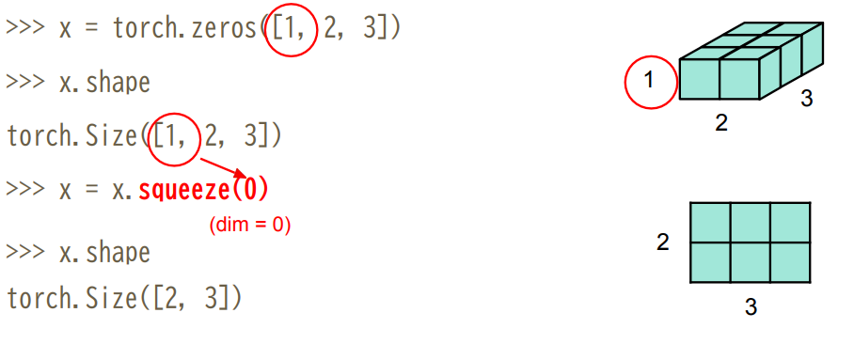
Tensors – Common Operations
Squeeze: remove the specified dimension with length = 1

Slide 24
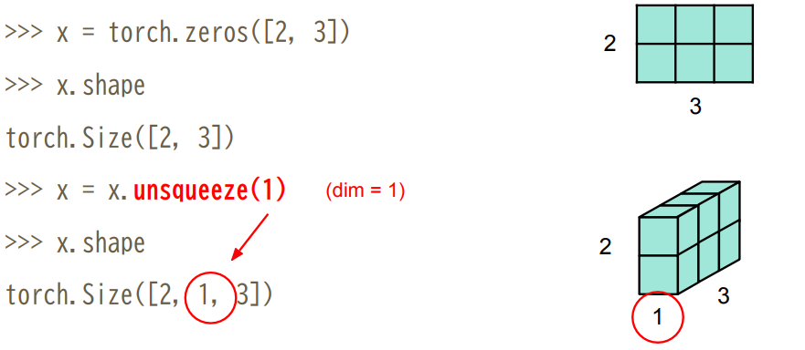
Tensors – Common Operations
Unsqueeze: expand a new dimension

Slide 25
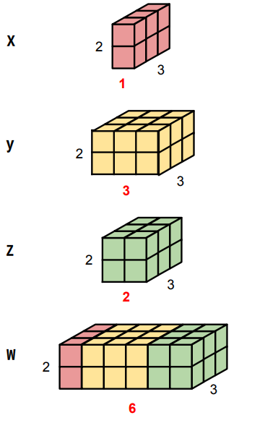
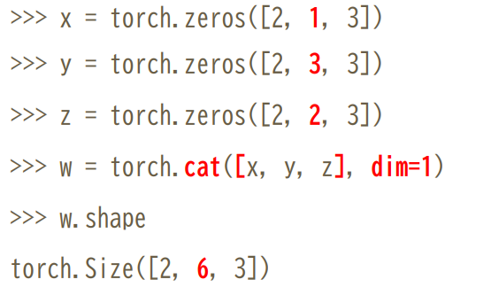
Tensors – Common Operations
Cat: concatenate multiple tensors

Slide 26
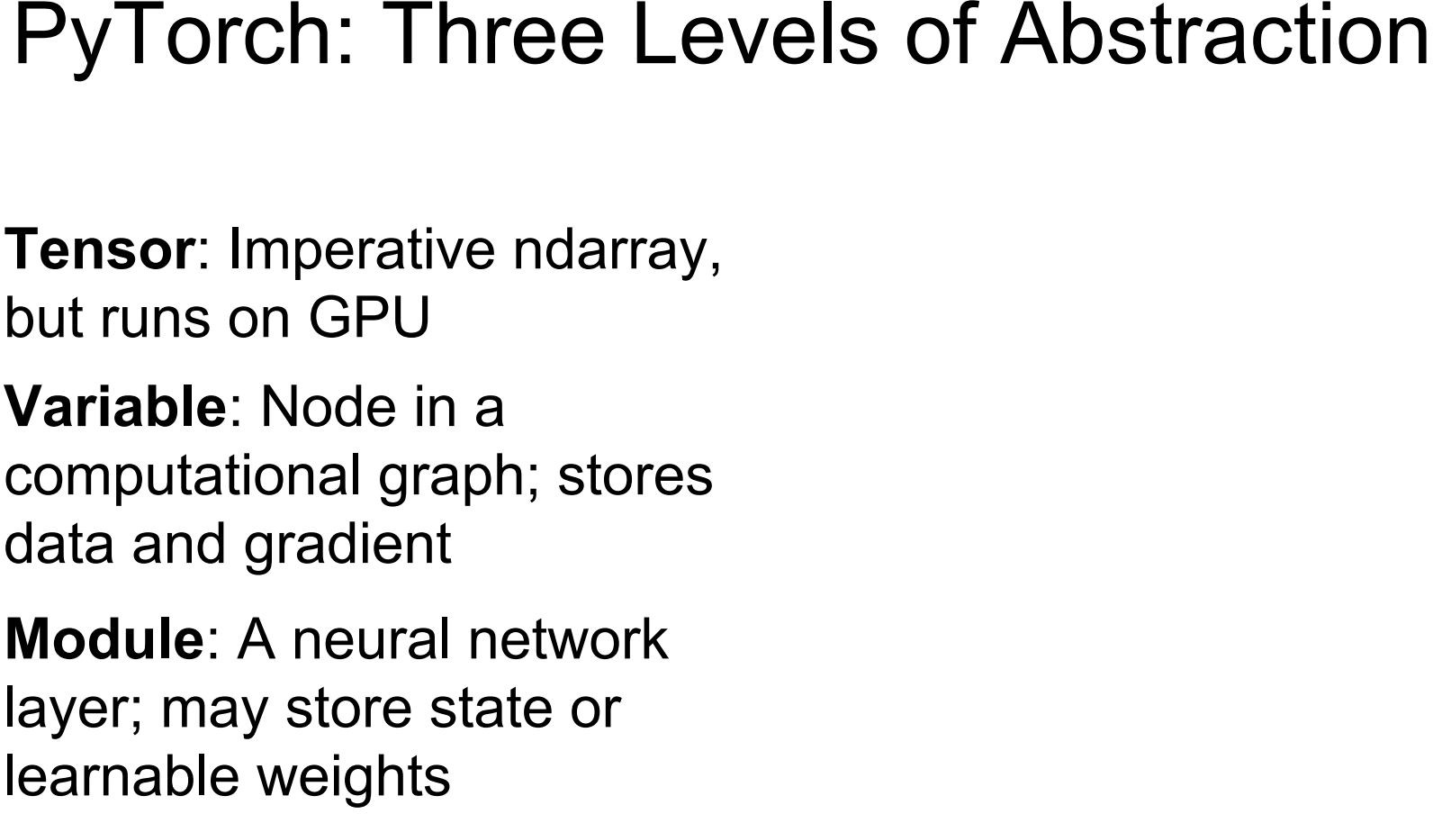
Stanford cs231n.

Slide 27
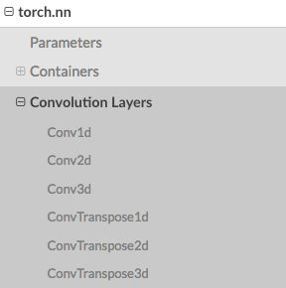
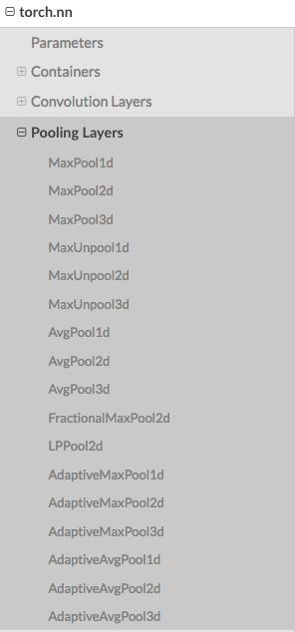
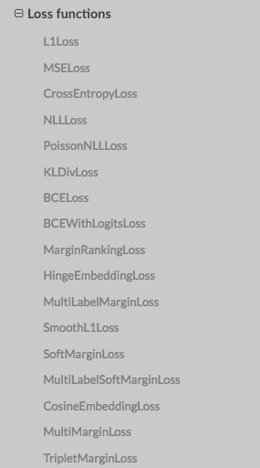
Module, single layer
Other layers: Dropout, Normalization Layer

Slide 28
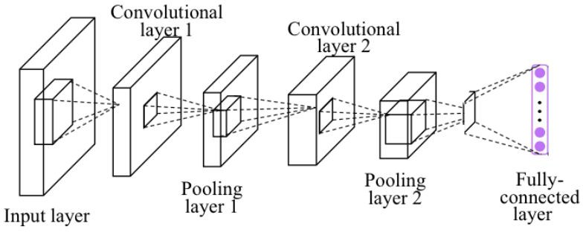
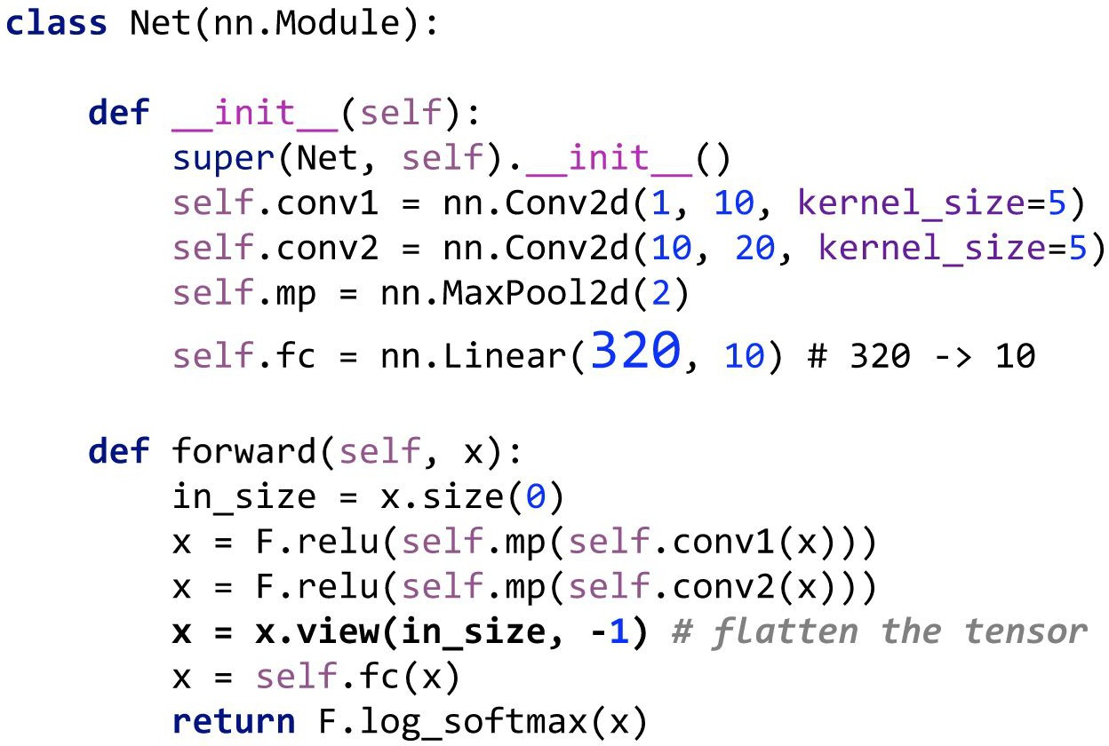
Module, network
Pytorch, zero to all. HKUST

Slide 29
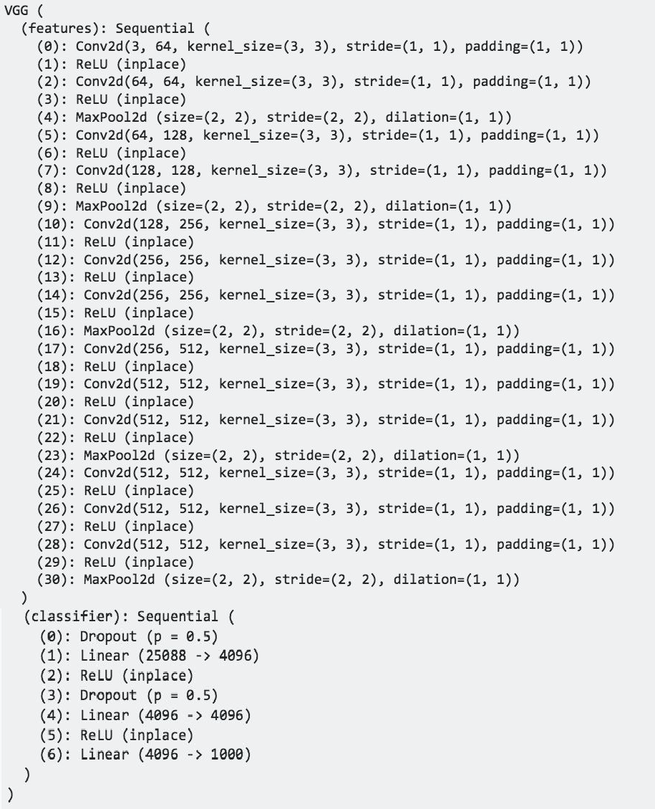
Module

Slide 30
When starting a new project
Data preparation ( processing, format )
Model Design ( pretrained, design your own Model)
Training Strategy

Slide 31
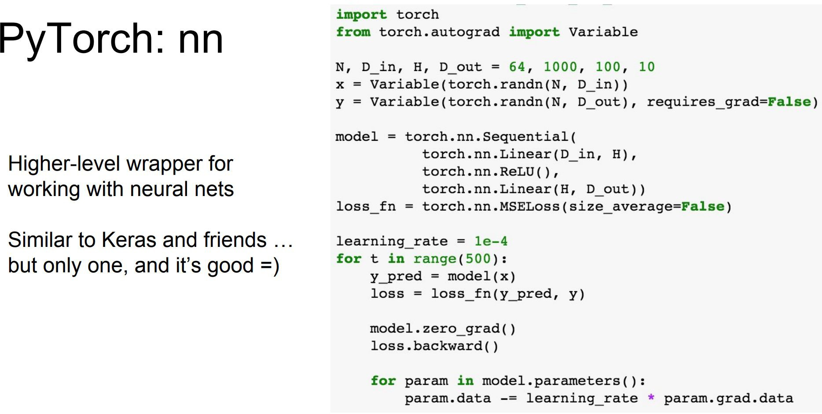
Train a simple Network
Stanford cs231n.

Slide 32
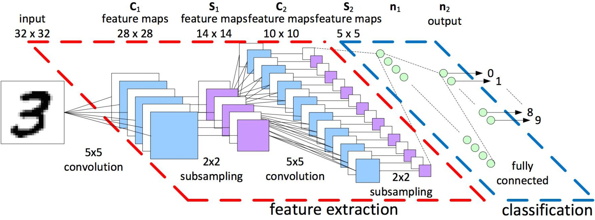
Train a simple Network
Forward: compute output of each layer
Backward: compute gradient
Update: update the parameters with computed gradient

Slide 33
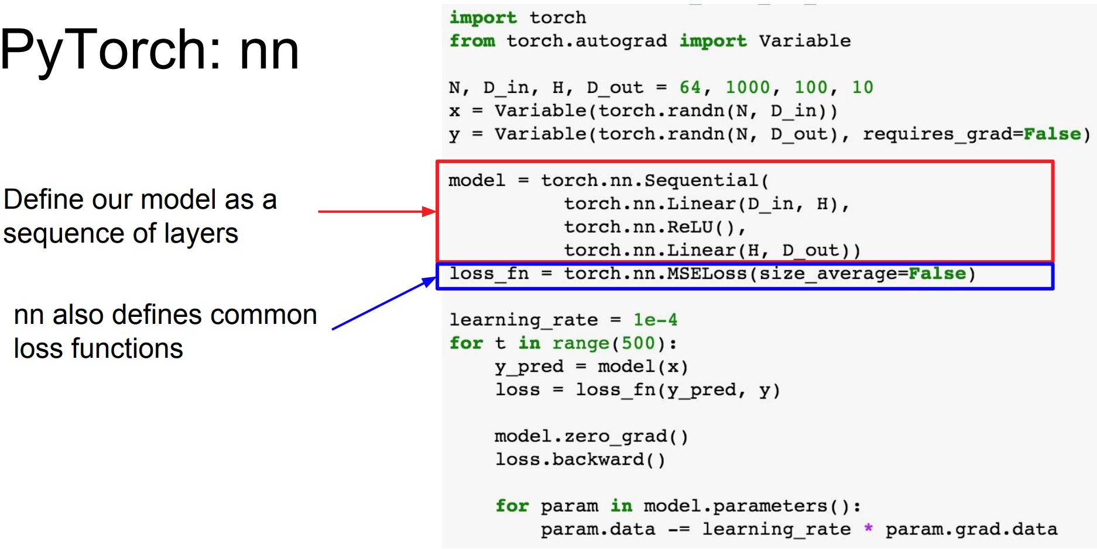
Train a simple Network
Stanford cs231n.

Slide 34
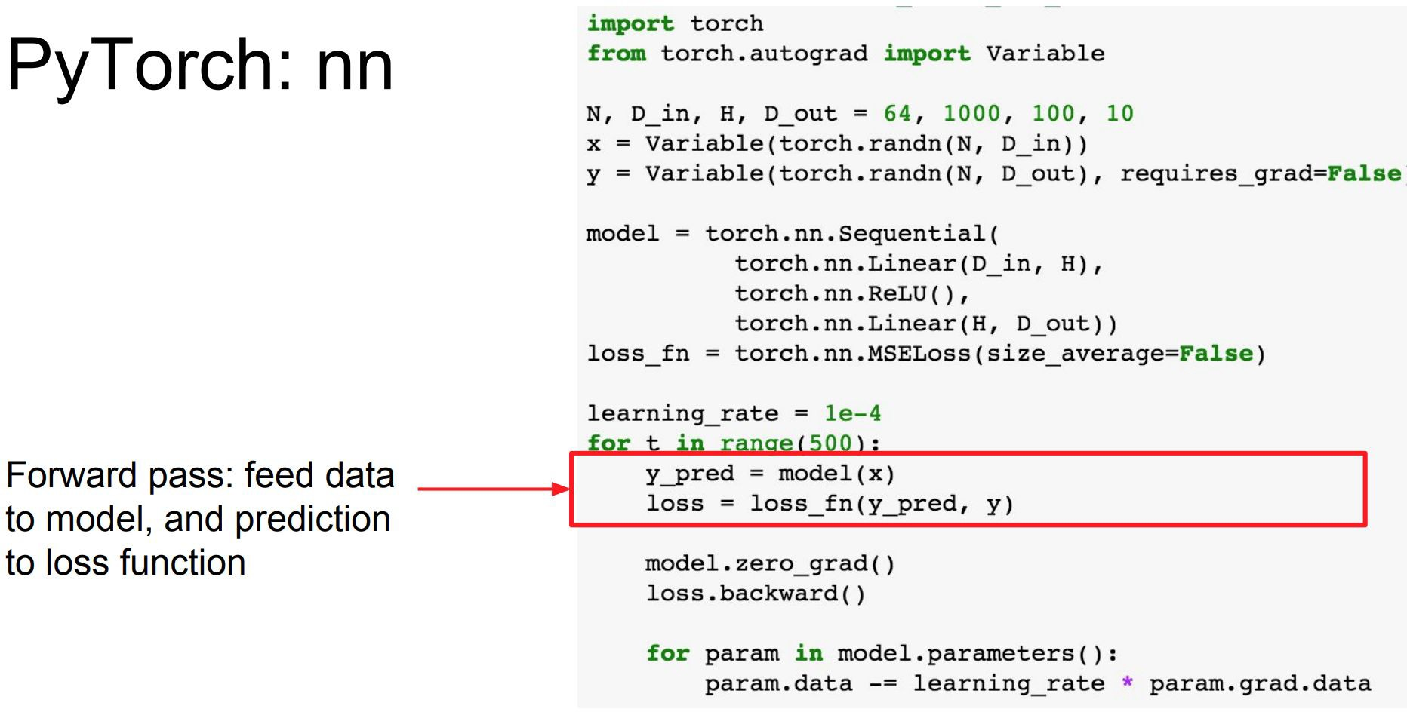
Train a simple Network
Stanford cs231n.

Slide 35
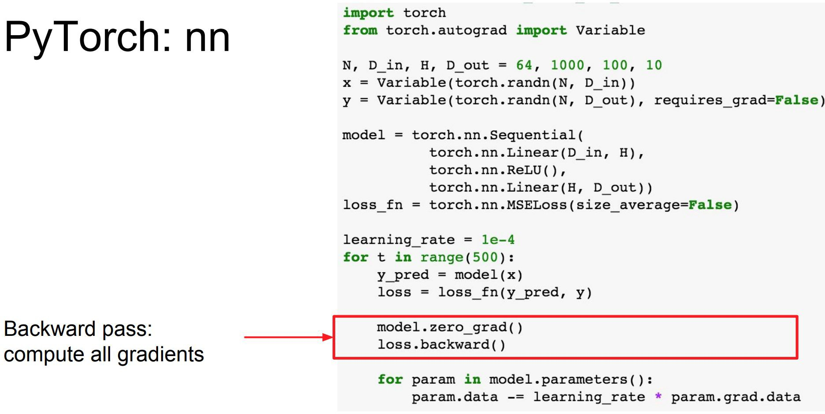
Train a simple Network
Stanford cs231n.

Slide 36
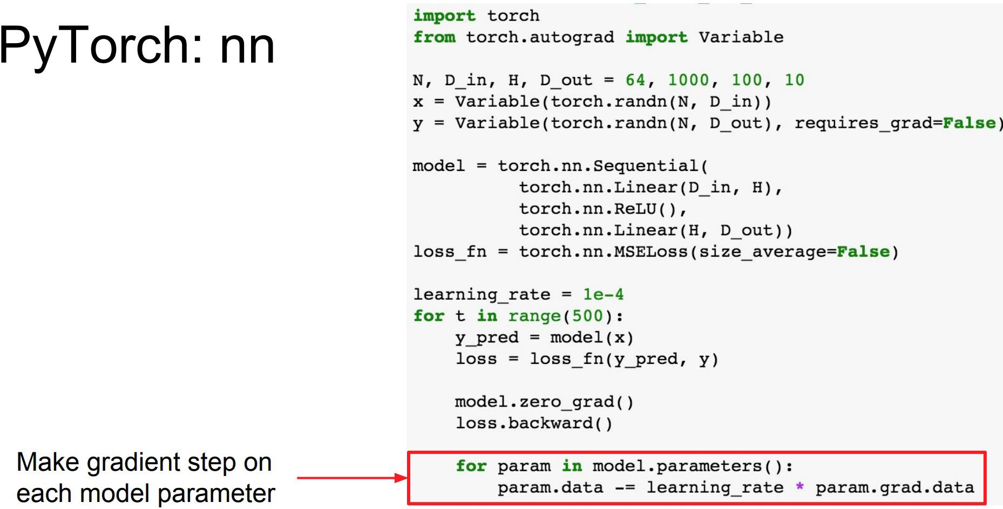
Train a simple Network
Stanford cs231n.

Slide 37
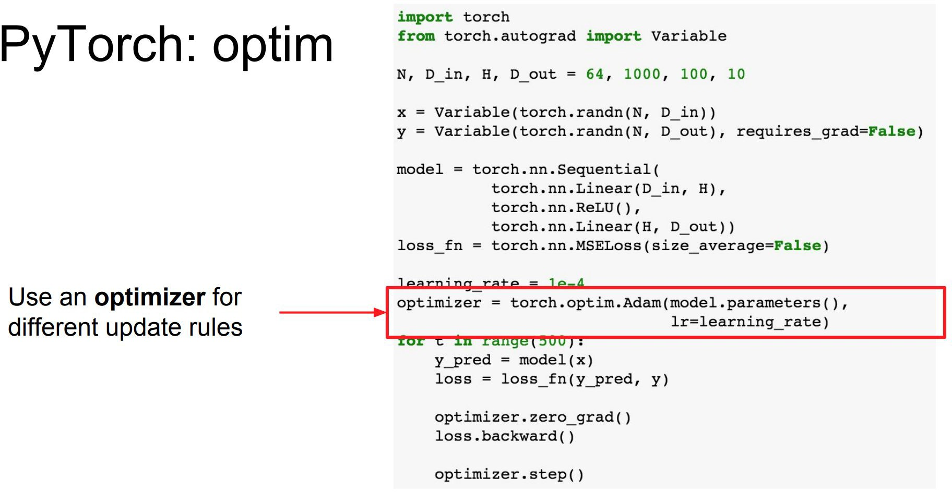
Train a simple Network
Stanford cs231n.

Slide 38
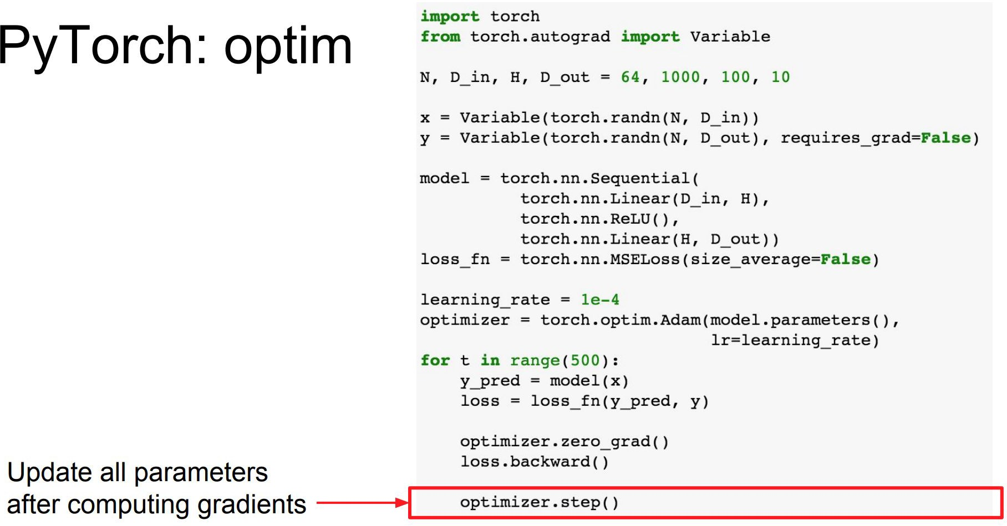
Train a simple Network
Stanford cs231n.

Slide 39
MNIST example

Slide 40
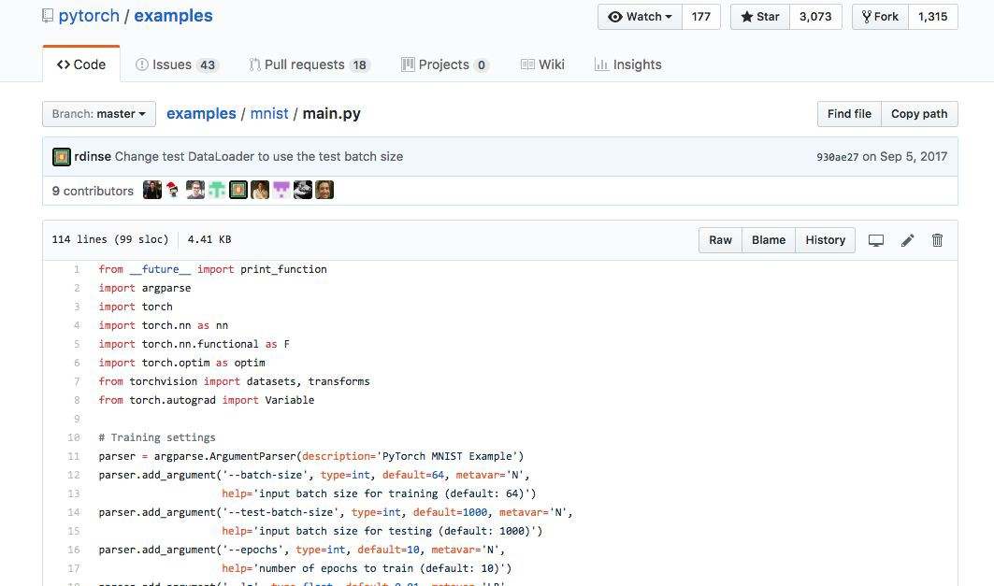
MNIST example

Slide 41
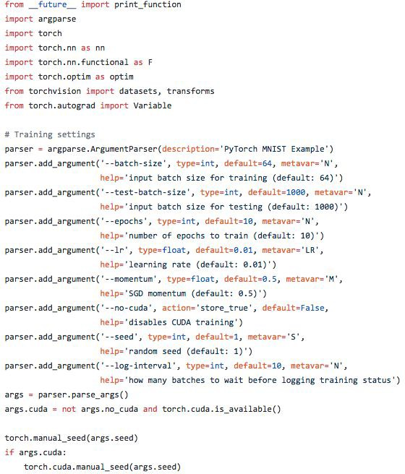
MNIST example
https://goo.gl/mQEw15

Slide 42
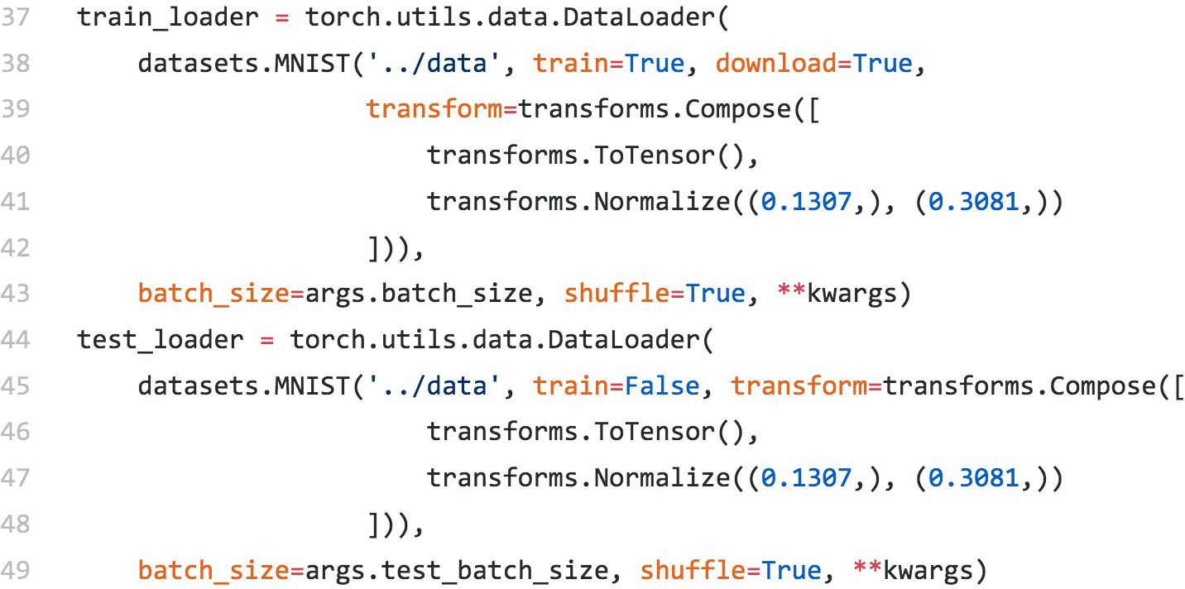
MNIST example
Data Loading
https://goo.gl/mQEw15

Slide 43
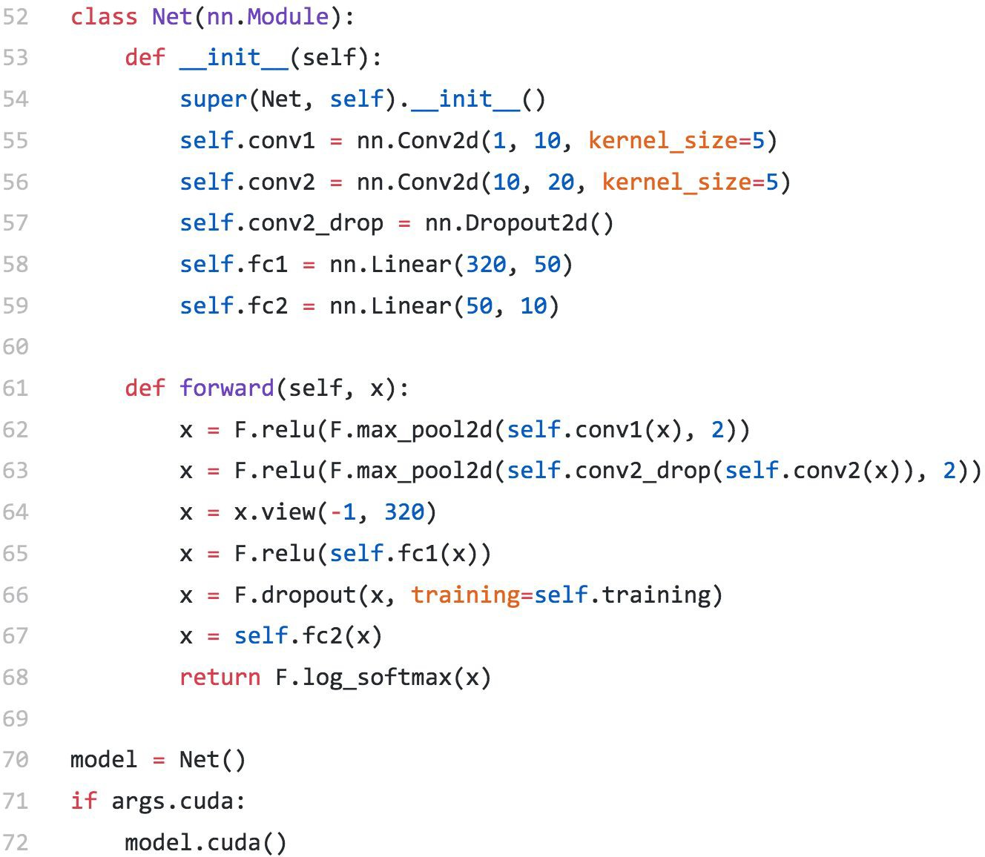
MNIST example
Define Network
https://goo.gl/mQEw15

Slide 44
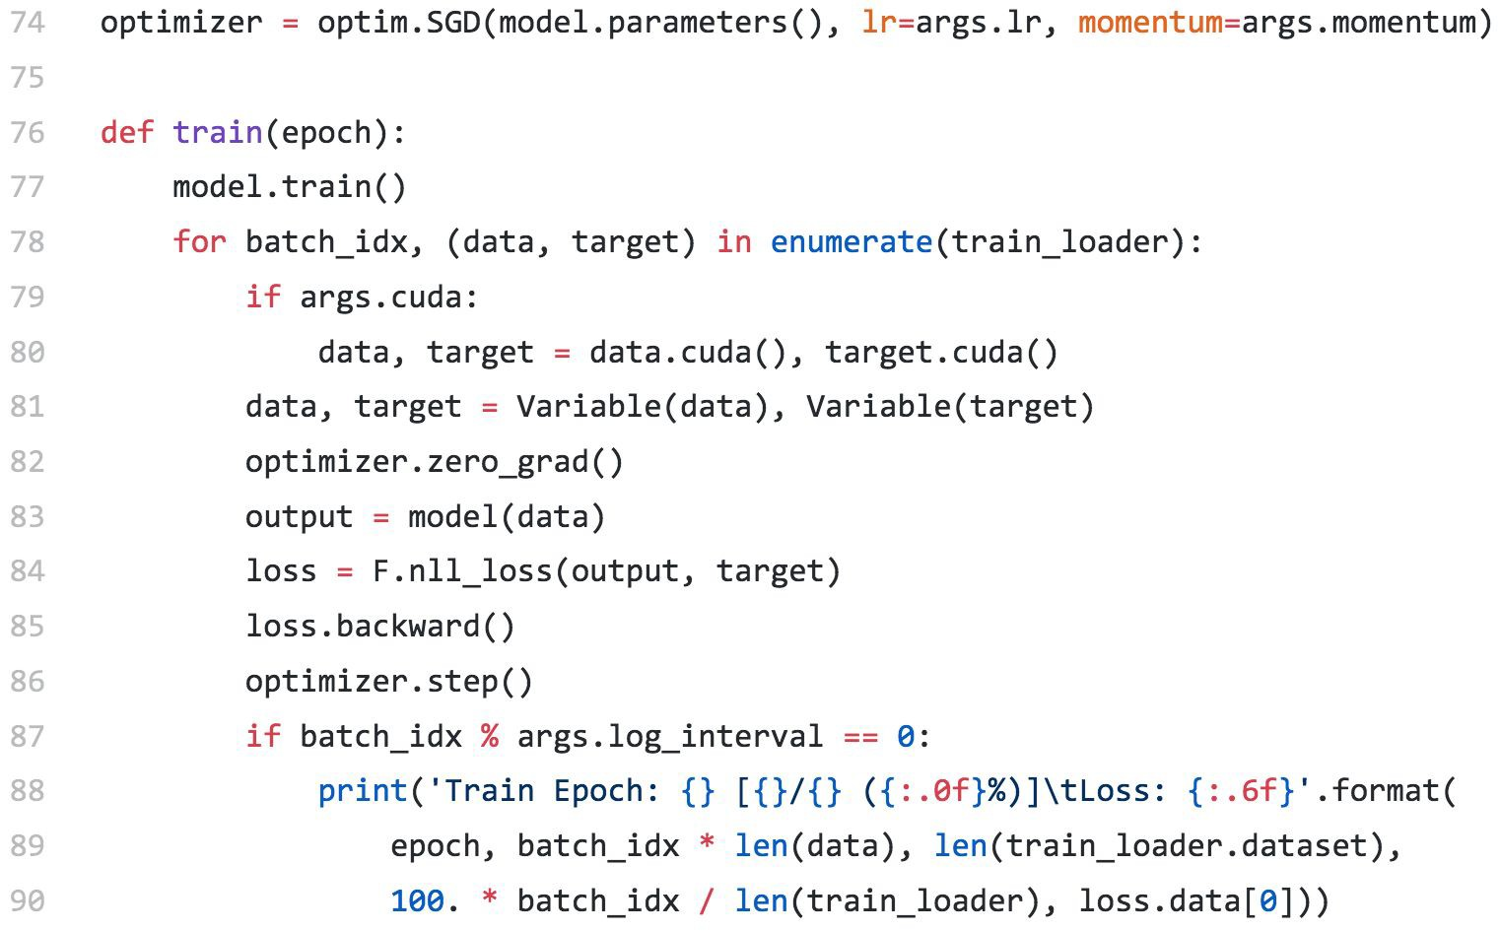
MNIST example
Training
https://goo.gl/mQEw15

Slide 45
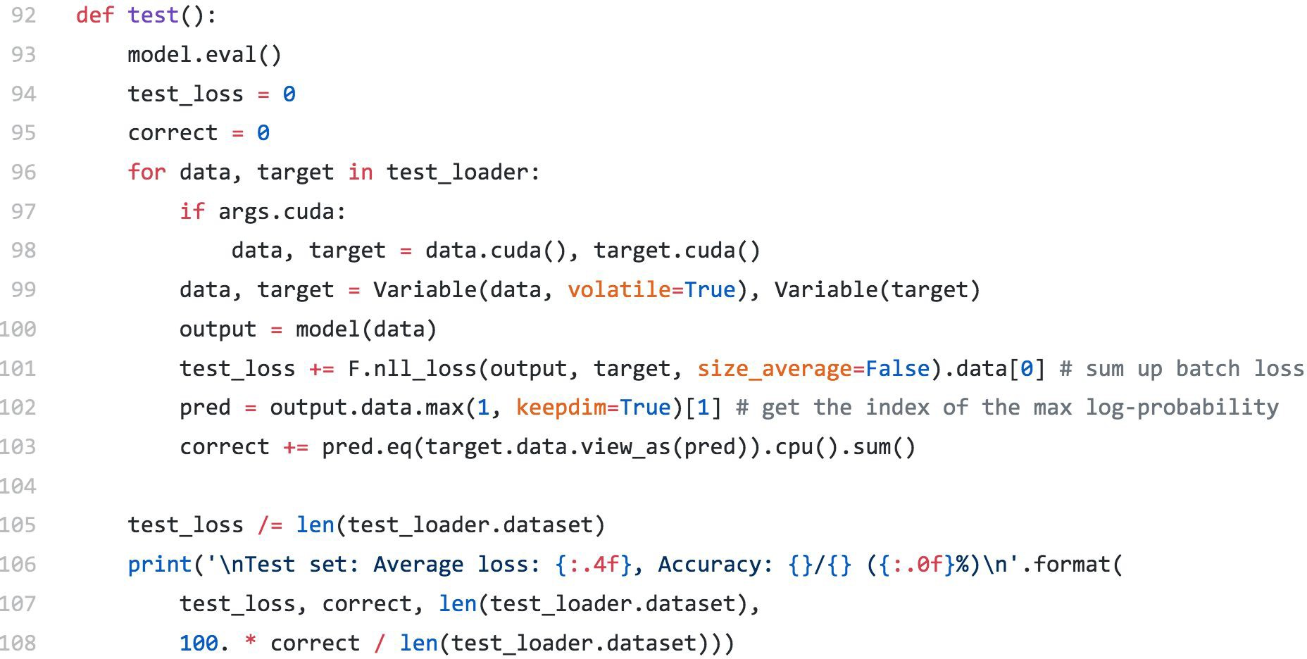
MNIST example
Inference
eval() mode:
*Dropout Layer
*Batchnorm Layer
https://goo.gl/mQEw15

Slide 46
When starting a new project
Data preparation ( processing, format )
Model Design ( pretrained, design your own model)
Training Strategy

Slide 47
Data Loading

Slide 48
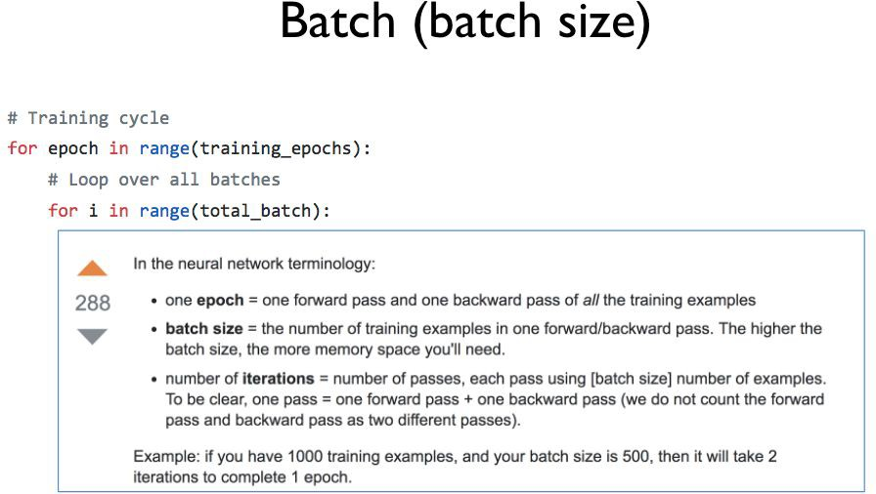
Data Loading
Pytorch, zero to all. HKUST

Slide 49
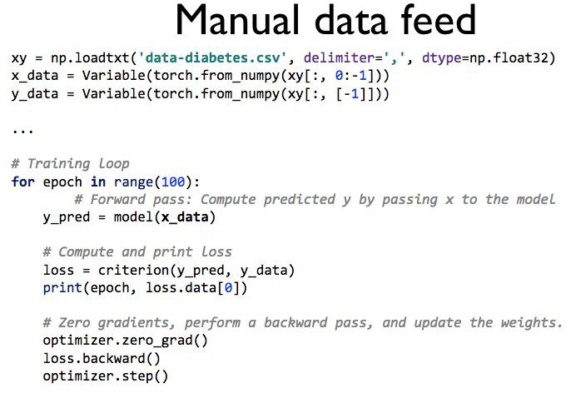
Data Loading
Pytorch, zero to all. HKUST

Slide 50
Data Loading
https://goo.gl/mQEw15

Slide 51
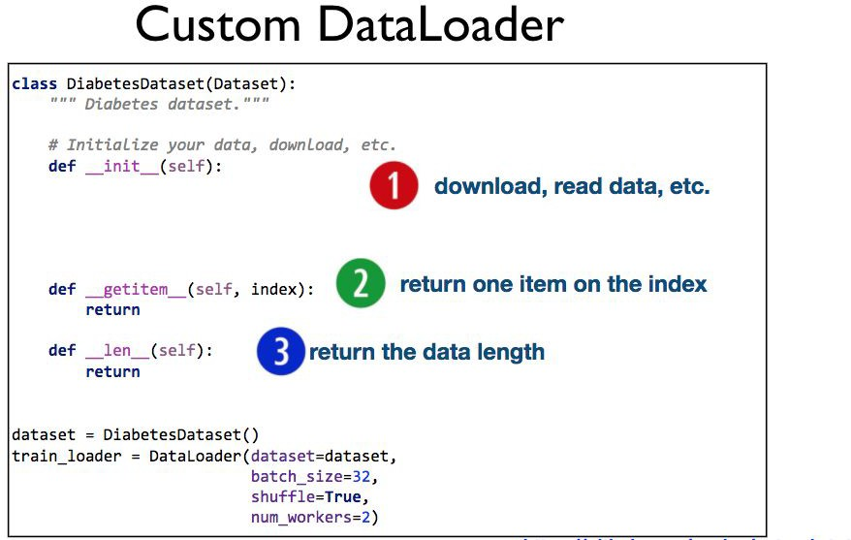
Data Loading
Pytorch, zero to all. HKUST

Slide 52
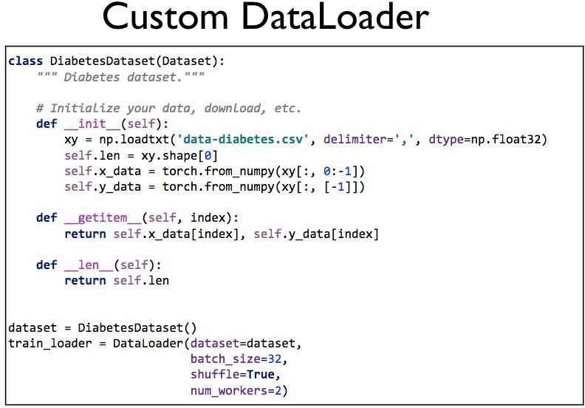
Data Loading
Pytorch, zero to all. HKUST

Slide 53
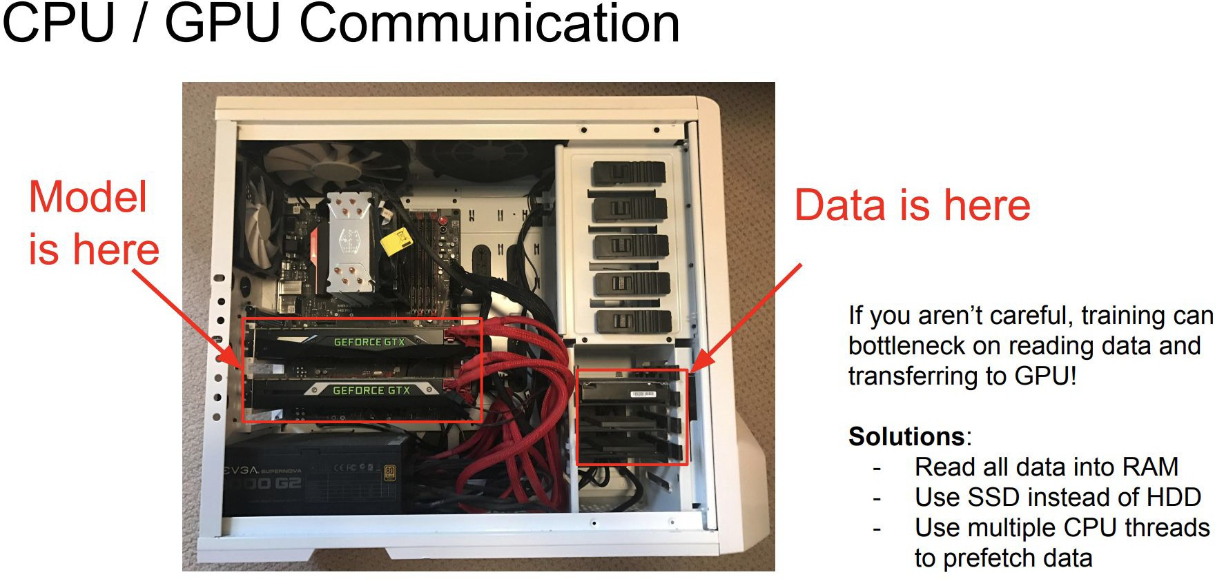
Data Loading
Stanford cs231n.

Slide 54
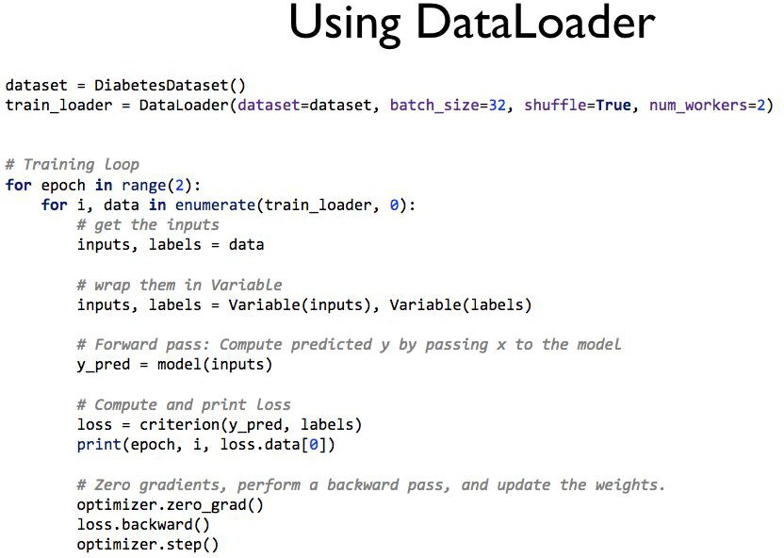
Data Loading
Pytorch, zero to all. HKUST

Slide 55
Data Processing
https://goo.gl/mQEw15

Slide 56

Data Processing
Pix2pix Code
https://github.com/junyanz/pytorch-CycleGAN-and-pix2pix

Slide 57
When starting a new project
Data preparation ( processing, format )
Model Design ( pretrained, design your own model)
Training Strategy ( learning rate )

Slide 58
Learning Rate Scheduler
Stanford cs231n.

Slide 59

Learning Rate Scheduler
torch.optim.lr_scheuler
StepLR: LR is delayed by gamma every step_size epochs
MultiStepLR: LR is delayed by gamma once the number of epoch reaches milestones.
ExponentialLR
CosineAnnealingLR
ReduceLROnPlateau
https://github.com/Jiaming-Liu/pytorch-lr-scheduler http://pytorch.org/docs/master/optim.html#how-to-adjust-learning-rate

Slide 60


Pretrained Model

Slide 61

Load Model
args.resume is the path to the trained model
Define the model
before loading parameters
https://gist.github.com/panovr/2977d9f26866b05583b0c40d88a315bf

Slide 62

Weights Initialization
net.apply( weights_init_normal)
https://goo.gl/bqeW1K

Slide 63



Weights Initialization
https://goo.gl/bqeW1K

Slide 64

Visualization, TensorBoard
https://www.tensorflow.org/get_started/summaries_and_tensorboard

Slide 65




Other resources:
pytorch document:
chatgpt, bard, claude
or just google it...

Slide 66
Thank You

